Slide 1
Software Engineering and Architecture
Interface Segregation Principle
Role- and Private Interfaces

Slide 2
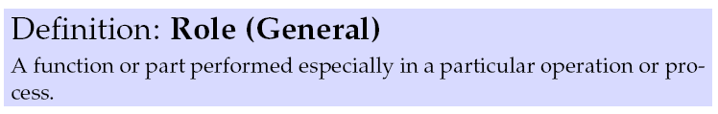
Roles…
Role (Da: Rolle / function)
… will be treated in much more detail soon, but…
We know the concept from plays and acting
  Daniel Craig plays the role of James Bond
And in the more general understanding of a function
  It was the nurse’s role to tend to the patient
  It is the physician’s role to plan a treatment for the patient

Slide 3
Role-Person
Roles are ‘played’/’fulfilled’ by persons
  The one that ‘does the function / fulfill the responsibilities’
  James Bond is played by Sean Connery in this movie
  The SWEA censor today is Clemens Klokmose
  The physician on duty on the ward today is Jens Madsen
  The host on the news broadcast today is …
A role can be played by many different persons
  Of course, if they are trained and skilled to fulfill the role…

Slide 4
Role-Person
A person can play many different roles
  Example: My roles:
    Teacher, researcher, husband, father, taxpayer, colleague, friend, …
But they are only accessible for a given audience
  I am a father and a teacher. Each with responsibilities…
  But not all have access to all my roles, of course
    Student: “Could you explain the ‘Role’ concept in programming?”
      Yes, I will do that. That responsibility belongs to the Teacher role.
    Student: “Please, Henrik, can you fix my flat bike tire?”
      No, I will not! That responsibility belongs to the Father role
    Child: “Can you fix my flat bike tire?”
      Hm hm, ok, but I am going to teach you to do it yourself…

Slide 5
Roles define Access
So – depending on the role of the requester some requests are allowed and some are not
  Only persons in ‘my children role’ interact with my father interface
    Example: fix flat tire responsibility
  Only Danish Tax may interact with my taxpayer interface
    Example: provide yearly earning responsibility
  Only the person in ‘my wife role’ interact with my husband interface
    No examples ☺

Slide 6
Bottomline
Role – Person is a many-to-many relation
  One role played by many persons
    But the person needs to fulfill the requirements/training to play role
  One Person plays many roles
    But access to a given role, requires a specific role by the audience
Person
Role
*
*

Slide 7
Relating to Software

Slide 8

Roles…
We use interface in our OO language to express a role
  interface Game
    Express the responsibilities of our HotStone game
      Allow clients to inspect game state, play a card, attack a hero, etc.
  Interface Card
    Express the responsibilities of a HotStone card
      Store mana cost, health, etc. Allow clients to get those values.
  Interface RateStrategy
    Express the responsibility to compute parking time based upon a given amount of money

Slide 9
Role-Object
Objects implement/”play” these roles
  Class StandardGame implements Game { … }
  Game game = new StandardGame(….);
  Now we know that ‘game’ object can act as defined by the role ‘Game’
A role can be played by many different objects
  ‘Game’ is currently implemented by about 90 SWEA groups!
    All different (except if a group cheats ☺)!
  And AU GitLab probably have > 500 implementations of Game

Slide 10
Role-Object
Does it make sense to also think:
One object plays many different roles, depending upon who wants to access it?
Yes – we have already such a situation in HotStone!
The Game object is already used in two different contexts

Slide 11
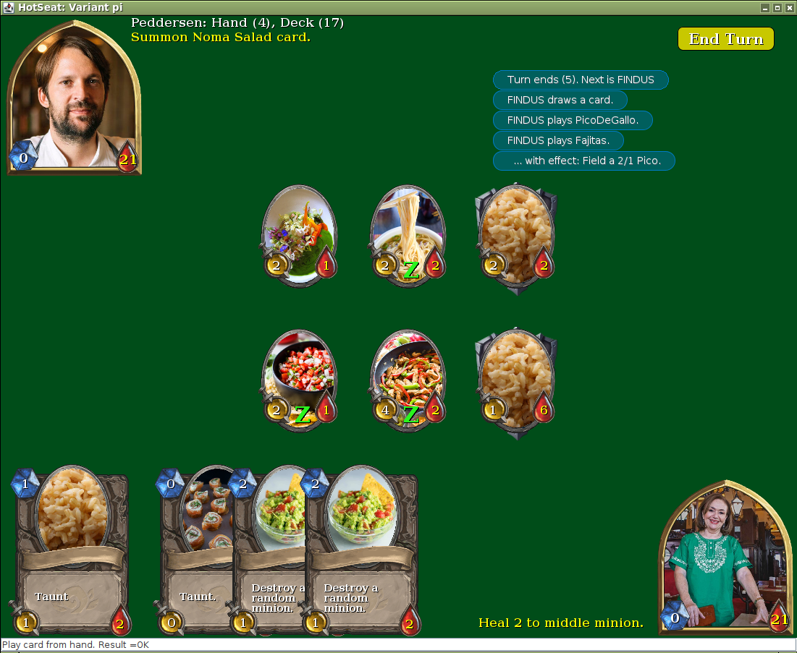
Game Roles
The UI needs to interact with the Game object
  But only by interacting via the Game interface’s method
    Which allows Game to ensure all HotStone rules are obeyed
      playCard(…) OK
      modifyHeroHealth(Findus, -2) Not OK
Game Object

Slide 12
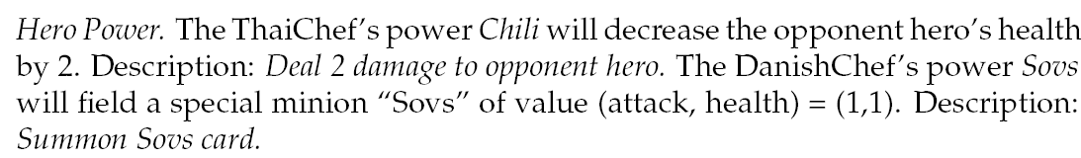
Game Roles
But we also have strategies that need to do more
  The Strategi to handle Hero Power needs more specialized access
      playCard(…) OK
      modifyHeroHealth(Findus, -2) Perfectly OK
Game Object
ThaiHeroPower
Strategy

Slide 13
And Actually…
We have the exact same situation with Card and Hero
  The UI must never change, say, health of Hero/Card
    As Game object then cannot guaranties rules are obeyed
  But the Game object of course needs to change all state in all heroes and all cards
    card.deltaHealth(-3);
Hero Object
Card Object

Slide 14
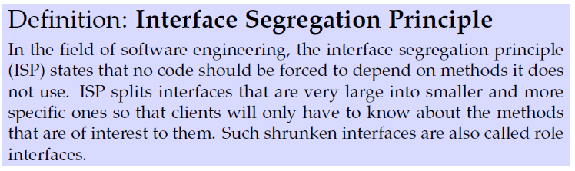
ISP
This is the Interface Segregation Principle
‘Do not depend on methods that you do not use’
Or – ‘delimit what methods a given object may access’
  My children are the only with access to my father interface
  My SWEA students are the only with access to my teacher intf.

Slide 15
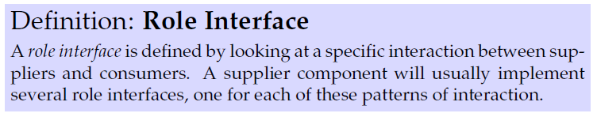
Fine-grained Roles
The ‘more specific’ role is expressed as a Role Interface
Ala again
  I provide a ‘teacher’ interface (one role interface)
  And a ‘taxpayer’ interface (another role interface)
  Etc.
Martin Fowler

Slide 16
So – Our Game Can
Have the UI oriented interface
  The current Game interface, in the handed-out code
Have a more specific interface, with more privileges to the strategies…
  Ala a ‘MutableGame’ interface or another appropriate name
    Only provided to the strategies
    Contains special mutators like for example
      deltaHeroHealth(Player who, int deltaValue);
Then
  class StandardGame implements Game, MutableGame {…}
  (class StandardCard implements Card, MutableGard {…})

Slide 17
Another Example
After the Autumn break, we will add a UI to HotStone
Building a UI for 2D graphics from the bottom up is tedious
So, we use a library/framework: MiniDraw
  The central ‘collection’ of graphical elements on-screen is the Drawing role

Slide 18
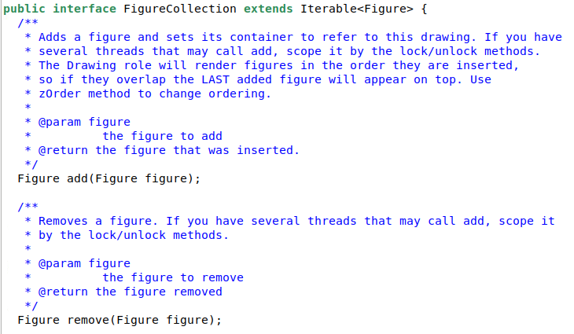
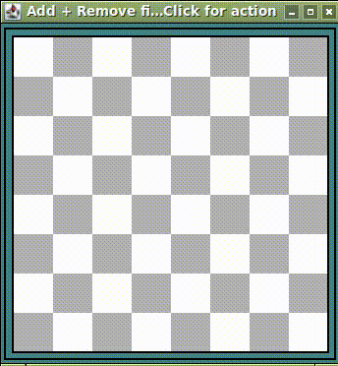
Example
The FigureCollection in MiniDraw only deals with adding, removing, and iterating the collection of Figures in MiniDraw
A specific interaction (add+remove) between the UI and the Drawing, expressed as the Role Interface ‘FigureCollection’

Slide 19
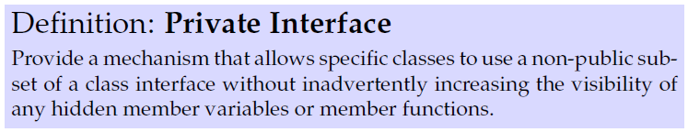
Private Interface
Role interfaces are often used to enforce more specific encapsulation than is possible using private/public methods and instance variables…
Let us make an example, highly inspired by our project…
James Newkirk

Slide 20
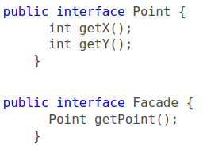
Example
We have a system/framework/Façade which presents (x,y) points to outside code, but that outside code must never modify the (x,y) values!
Read-only Role interface is a solution to that.
  Only accessor methods,
  no mutator methods…
  (Analogy:
    Façade = Game
    Point = Card)

Slide 21
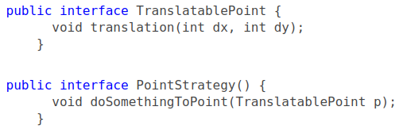
Example
However, internal classes inside the Façade of course needs to mutate the state of these (x,y) points.
Let us say that one class needs to translate (dx,dy) points
Private Interface is a solution to that

Slide 22
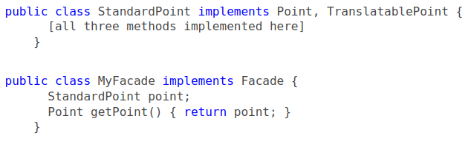
Example
Now the internal, implementing, class of course implements both
That is, if you use ‘getPoint()’ from the outside you only get access to ‘getX()’ and ‘getY()’

Slide 23
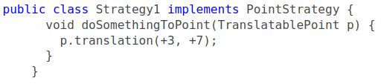

Example
Now, an internal PointStrategy can translate points like
And can be called internally like

Slide 24

Example
However, a PointStrategy cannot access (x,y)…
However, of course it is often the case, that we need just that.
Exercise: How do we solve that?

Slide 25
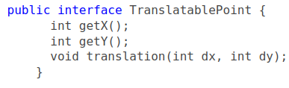
Solution 1:
Fine-grained solution: Missing accessor methods
  Just add those methods that are missing
Pro
  Can select just the right set of accessors
    (here it is both of them, but if read-only had 20, we may just pick the two we need).
Con
  Same methods are now present in two interfaces

Slide 26


Ups?
Uhum – how does that work in Java?
StandardPoint must now implement ‘getX()’ twice or???
Exercise: What happens?

Slide 27


Solution 2:
Coarse-grained approach: Extend existing interface
  Just implement both
Pro
  Less typing
  You can actually Program to an Interface in the façade impl!
Con
  You get all methods
TranslatablePoint

Slide 28
Mandatory Note
We have read-only role interfaces for Card and Hero in HotStone.
  But Game’s implementation and strategies need to manipulate them…
  Use private interfaces for that ☺!
Strategies needs special mutations of Game
  Use private interface(s) for that ☺!
Now you ‘program to an interface’, and avoid hard coupling to, say, StandardGame etc.

Slide 29
Mandatory Note
And iff you use the ‘extending existing interface’
  interface MutableGame implements Game { (mutators here) }
… you can now remove most casts and hard couplings to your StandardGame/StandardCard etc
  Map<Player, List<MutableCard>> handMap = …
  Interface HeroPowerStrategy {
  public void usePower(MutableGame game);
  }
… and still have the full flexibility of providing any concrete class that implements MutableX in your

